Slide 1


PROJECT PRESENTATION
TEAM 6
Autonomous Mobile Robot for Road Sign Board Detection
DHARMVIR DHARMACHARYA
SHIVANGI GUPTA
YASHIKA MITTAL
ABHISHEK SONI
MANAS SINHA

Slide 2
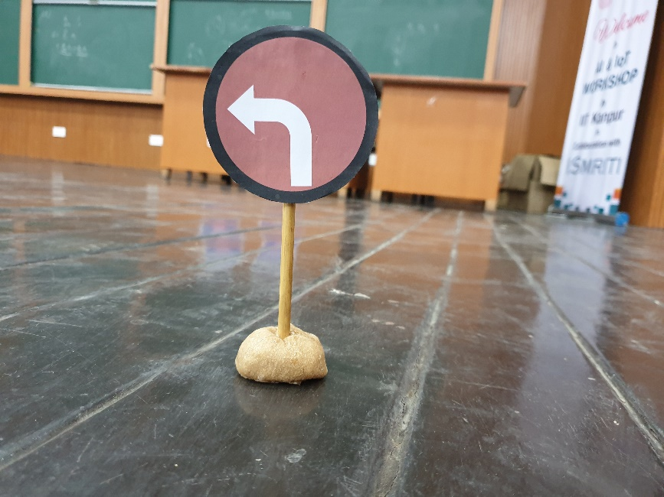
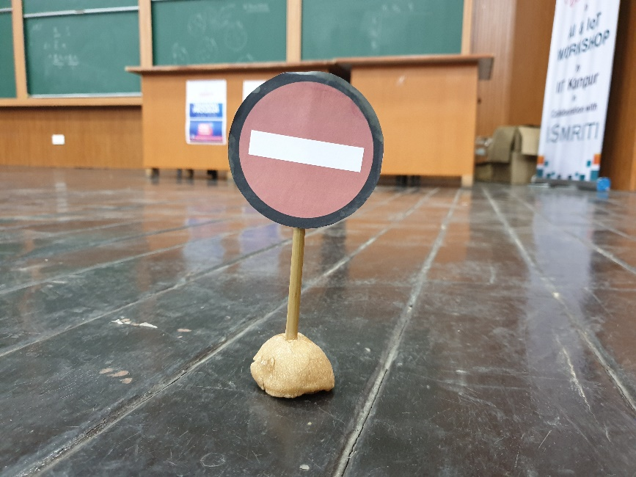
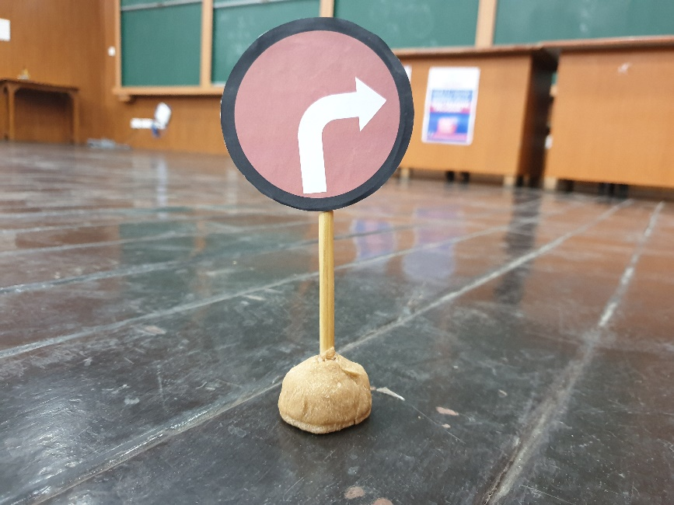
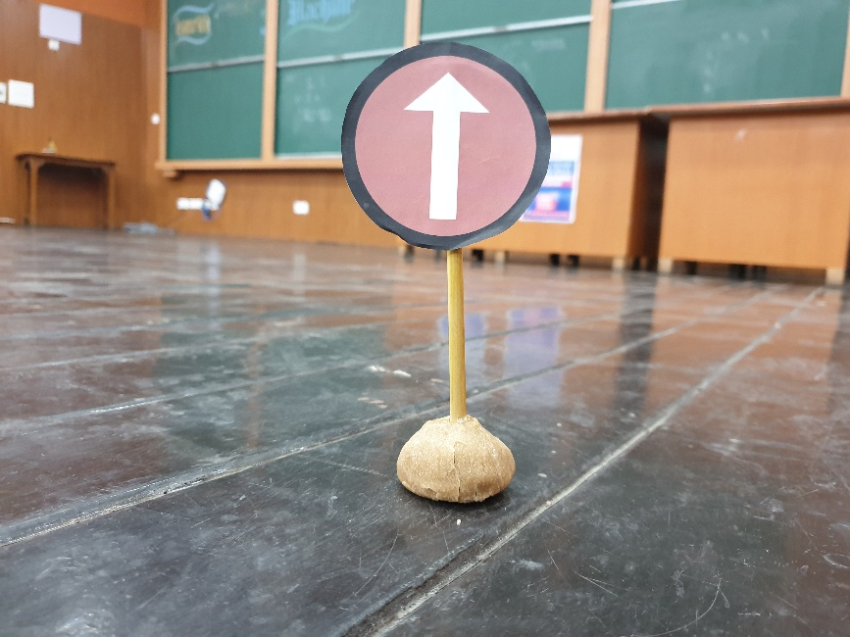
SIGN BOARDS

Slide 3
Connections
Microcontroller Used: Node MCU
Connect wheels to the motor driver shield
IN pin1 2 3 4 pins are connected to the D1,D2,D3,D4 pins
Enable pins of driver sheild are short circuited
VCC and ground pins taking from the node mcu to the 12 v 5 v to the vcc and ground to the ground pin of the shield

Slide 4
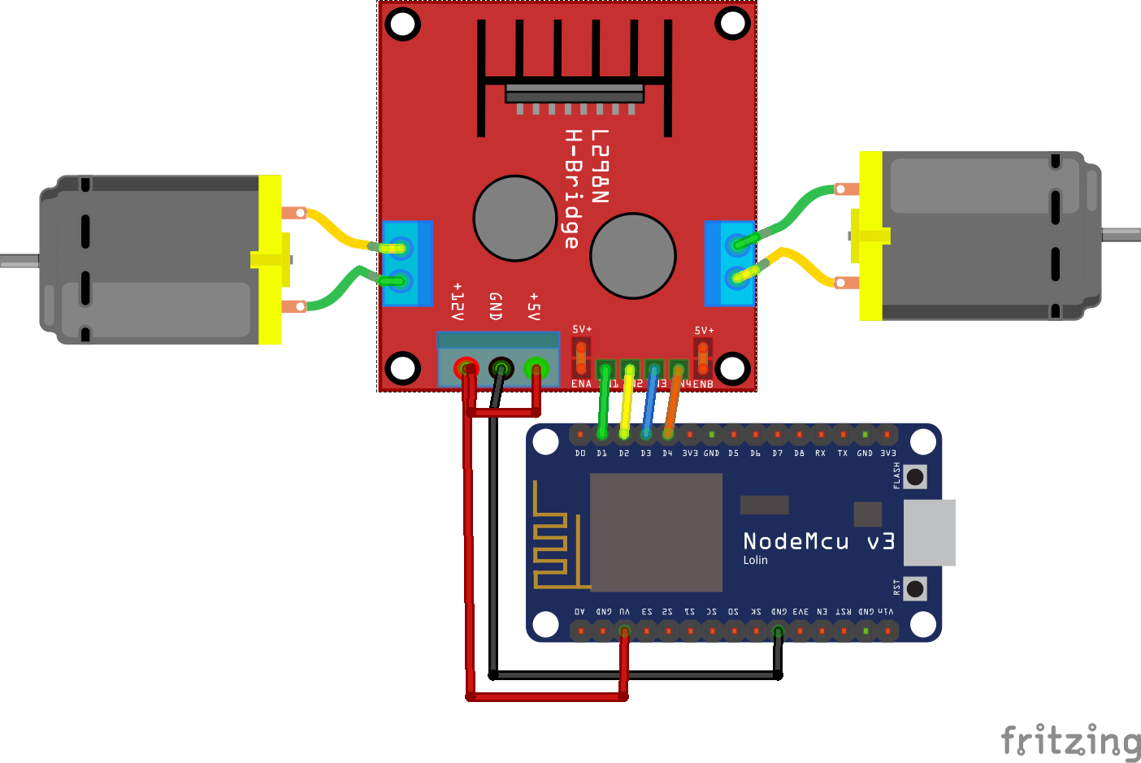

Slide 5
Detecting THE SIGNS
Find the circle in the frame.
Find the Dominant Color of the circle.
Find different zones inside the circle.
Compare the zones and thus determine the sign.

Slide 6
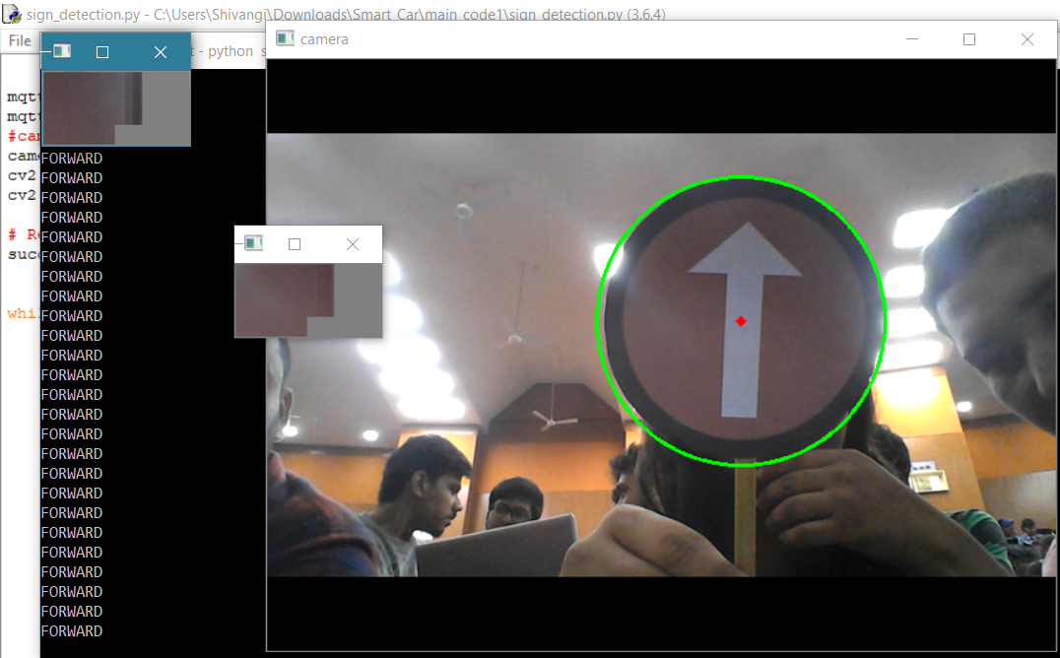

Slide 7
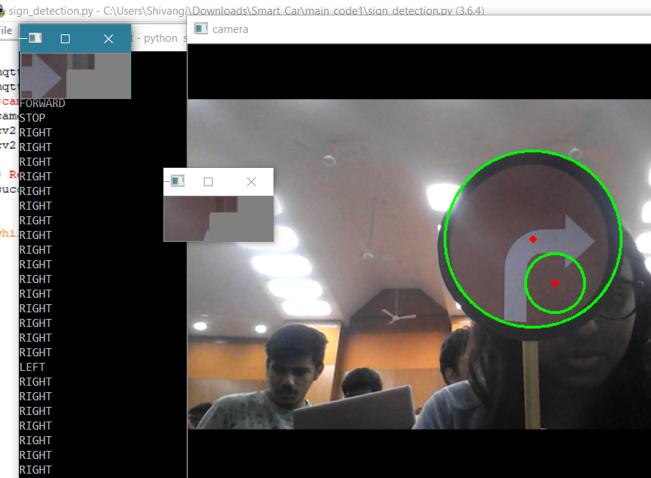

Slide 8
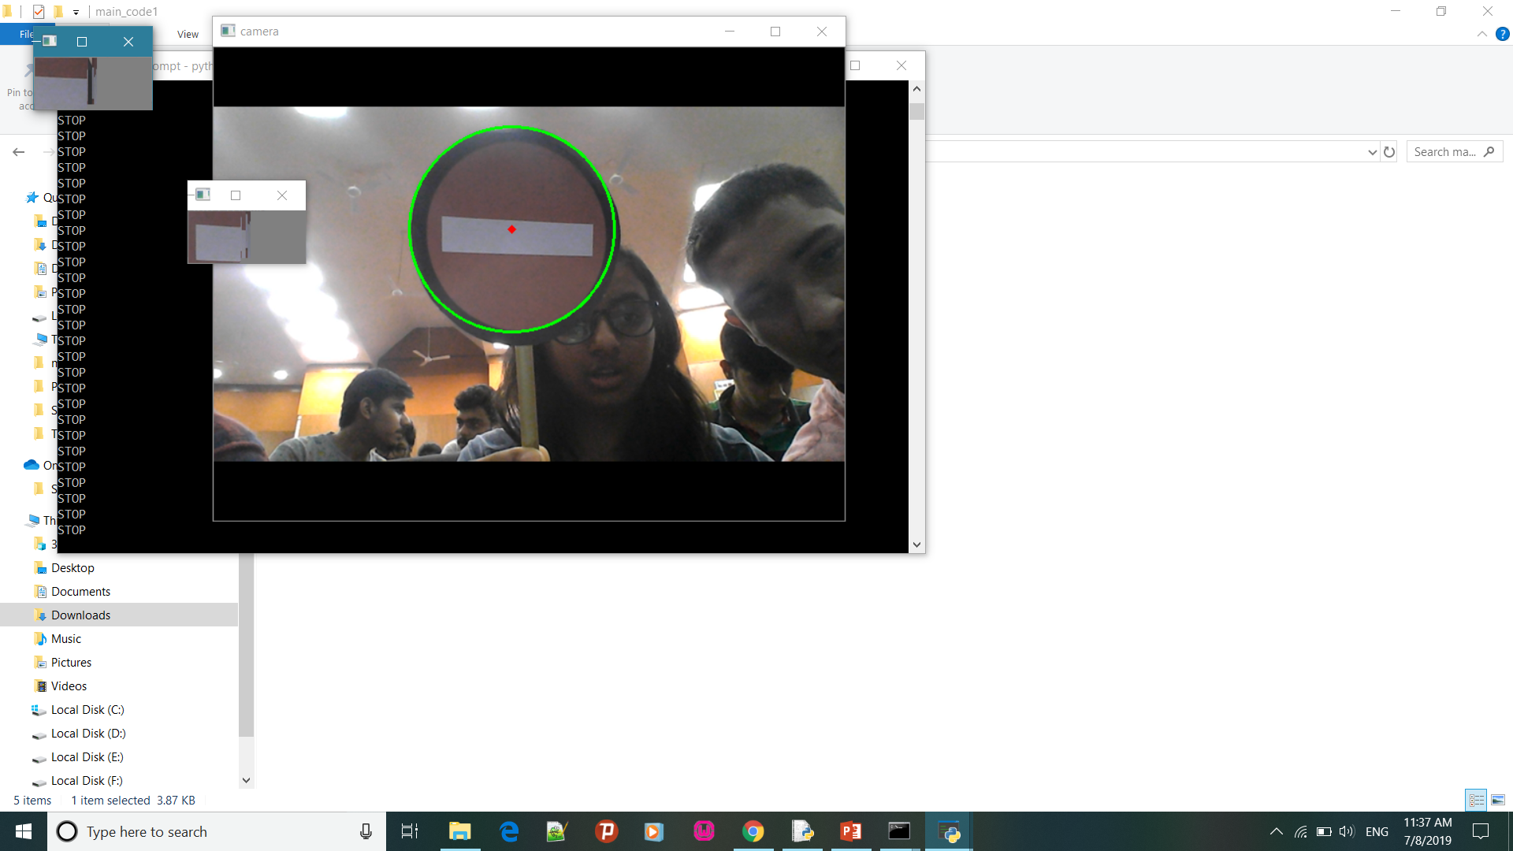

Slide 9
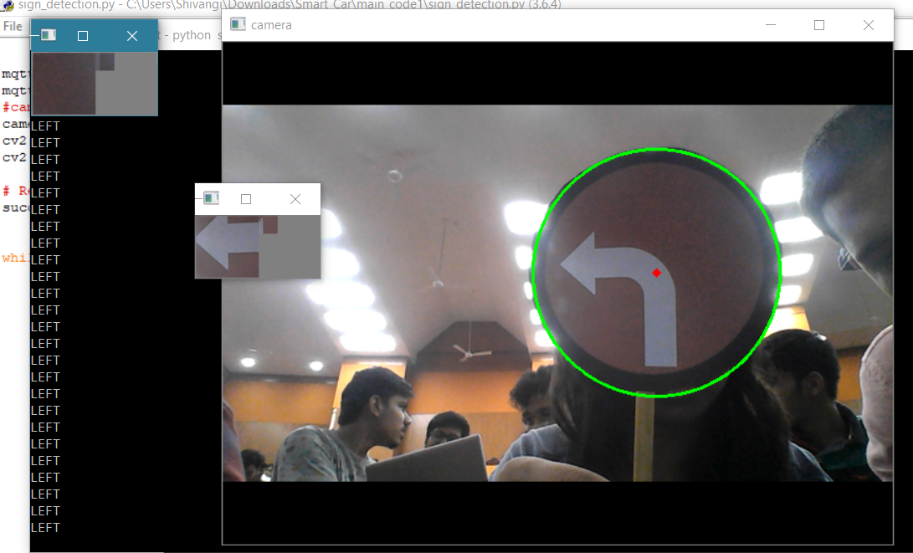

Slide 10
LET’s BE CODECASTIC!

Slide 11
WHEEL CONTROL
Receive the sign sent by the python code.
Set the default as forward.
According to the signal received control the wheel speed!

Slide 12
LET’s BE CODECASTIC!

Slide 13
WIRELESS CONNECTION
Set up the server suing MQTT Client System.
Declare a topic named ‘control’
The node MCU and the system will be the two clients of the server.
The system will publish the data.
The node the subscribe the topic and thus receive the data.

Slide 14
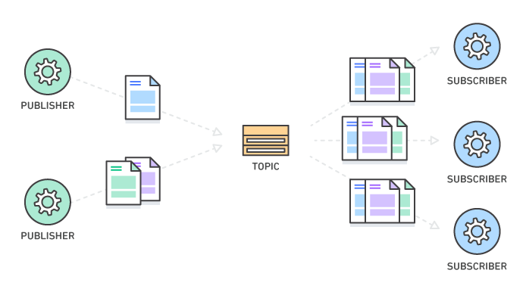
PUBSUB SYSTEM

Slide 15
LET’s BE CODECASTIC!

Slide 16
CHALLENGES FACED & AREA OF IMPROVEMENTS

Slide 17
WORK IN PROGRESS : THE AI MODEL

Slide 18
THANK YOU!

